Slide 2
Physics of Failure Testing FBG20N18
Test purpose: To expose devices to a range of DC and AC (Operating) stressors to evaluate capability and inform lifetime modeling of the 200V product platform
Life Switching Testing : Tested variations of VDS voltage, IDS current and Switching Frequency in a high side buck converter over a 2000Hrs time
VDS tested : 140V and 170V (Nominal) measured at Power supply and does not include any overshoot occurring at the DUT due to the buck circuit performance.
Iout tested : 1A, 3A
Stress Switching Testing : Tested variations of VDS voltage, IDS current and Switching Frequency in a high side buck converter over multiple 20Hour test times
VDS Tested : 60 to 240V (Nominal) measured at Power supply and does not include any overshoot occurring at the DUT due to the buck circuit performance.
Iout tested : 1 to 9A current limited by heat dissipation
Life DC Testing : Tested variations of VDS and VGS voltages over several temperatures over a 2000Hrs timeframe
VDS Tested : 200V, 230V, 250V at Temperatures of 100C and 130C
VGS Tested : 6V, 6.75V, 7.25V at Temperatures of 100C and 150C
Stress DC Testing: Tested variations of VDS and VGS voltages over temperature over multiple 20 hour test times
VDS tested : 160V to 300V at Temperatures of 110C, 130C, 150C
VGS Tested : 4V to 8.25V at Temperatures of 110C, 130C, and 150C

Slide 3
Switching LIFE
Parts were run for 2000hrs at selected conditions
Parts tested with full parametric test on Focused tester at interim steps 48,hrs, 120hrs, 260hrs, 500hrs, 1000hrs, 2000hrs
No failures have been observed so far thru 1500hrs

Slide 4
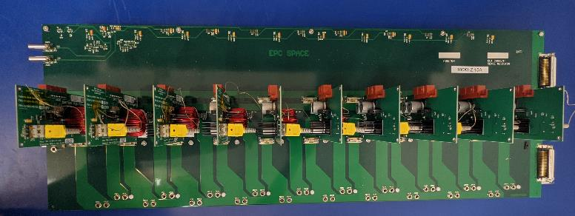
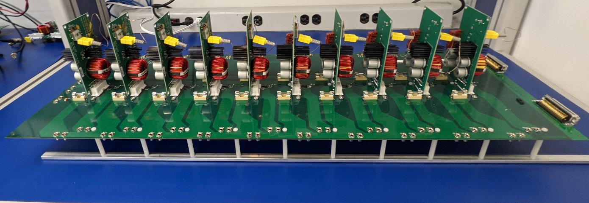
POF Life/Stress Switching Test Boards
Clock distribution adds delay along the devices
Odd devices are 0deg and even are 180deg
Sig Gen in
0 deg and 180deg
Mux outputs.
Measure Iin, Iout, and Vout
Also measure DUT Temp
Main Bus Power In
Device loads are external

Slide 5
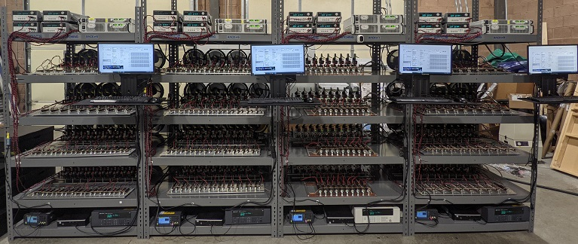
200V POF SWITCHING LIFE TEST RACK
140V
170V
Rack 5- 500Khz 1A
Rack 6- 100Khz 1A
Rack 7- 100Khz 4A
Rack 8- 500Khz 3A

Slide 6
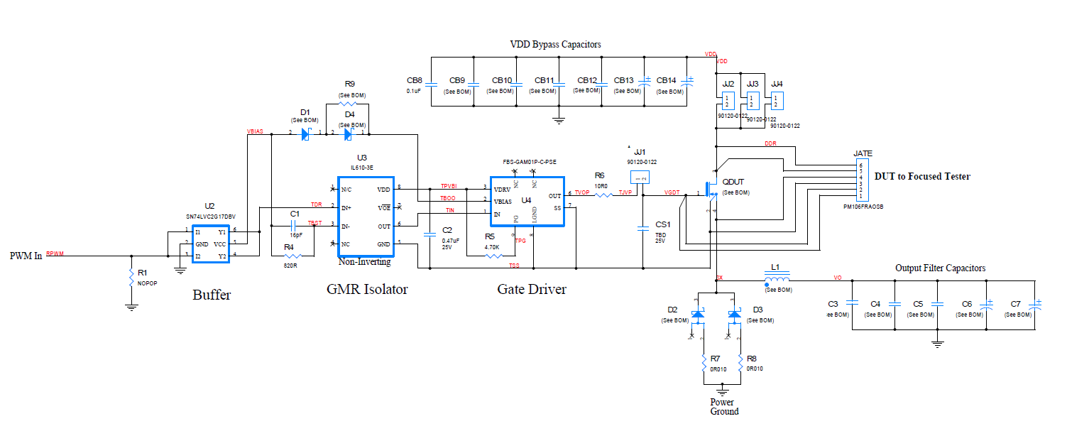
DUT Simplified Schematic

Slide 7
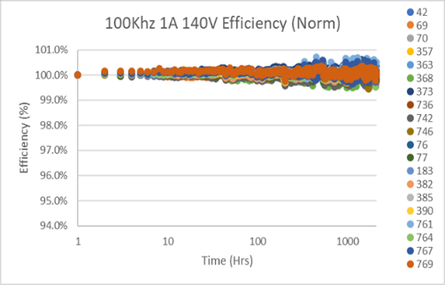
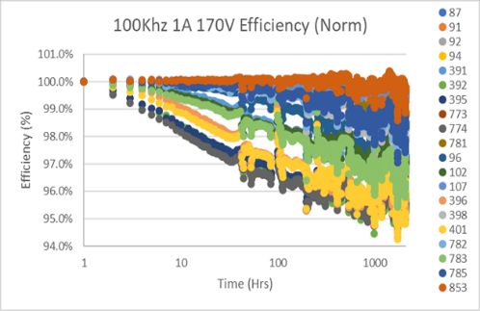
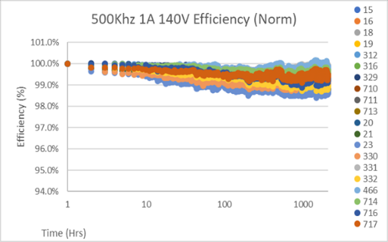
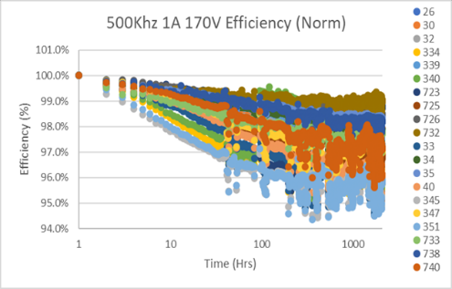
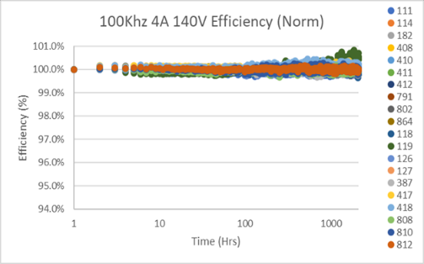
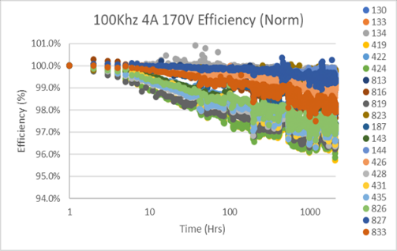
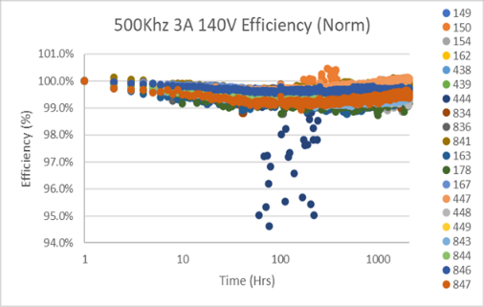
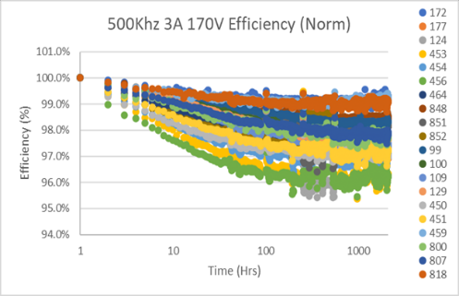
20N18 Efficiency Normalized
Take away : Efficiency dependent to drain voltage no current dependence .
Temperature seems to slow down the Drdson effect thru annealing . ( more pronounced on 100V device analysis)

Slide 8
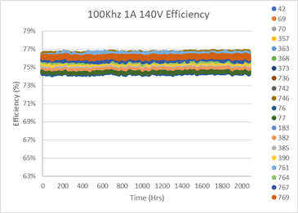
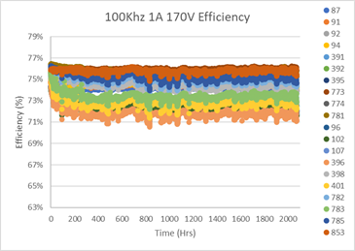
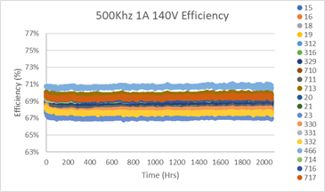
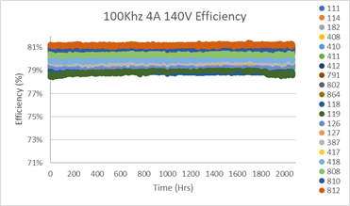
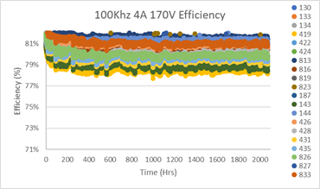
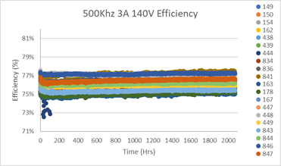
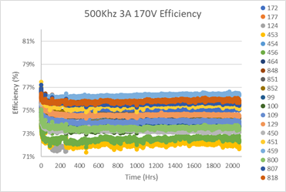
20N18 Efficiency (raw data)

Slide 9
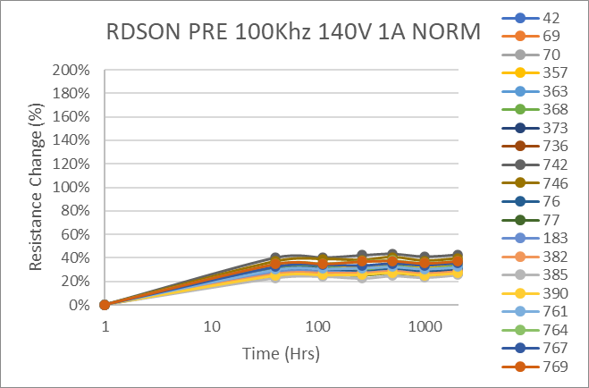
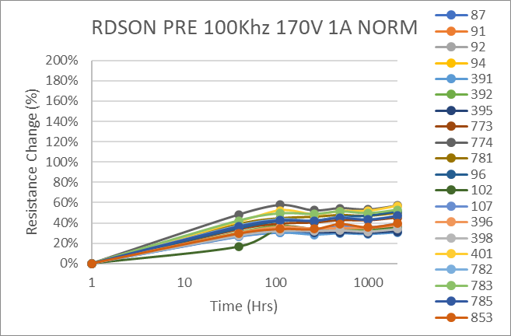
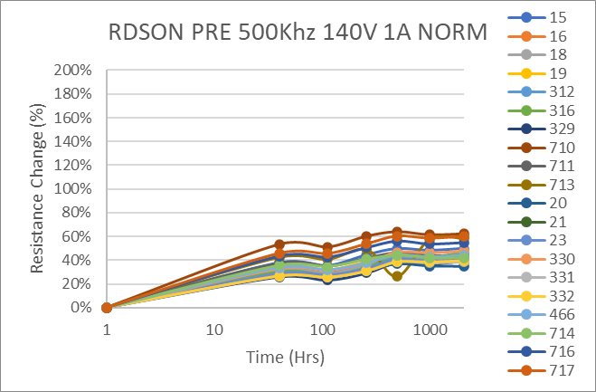
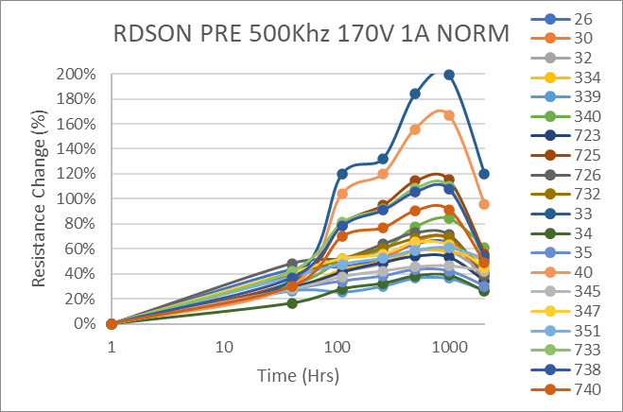
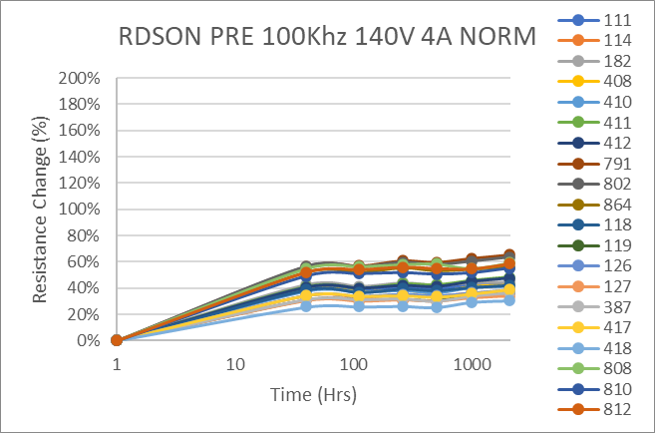
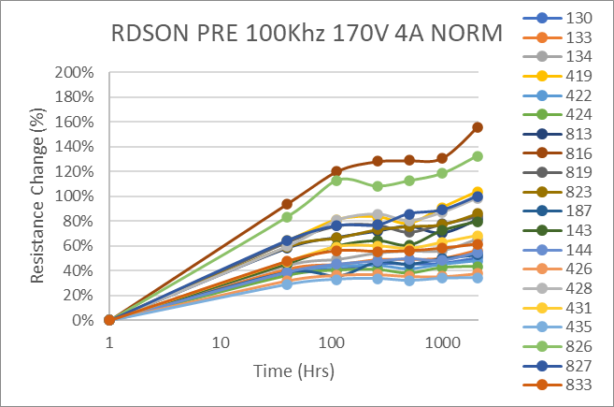
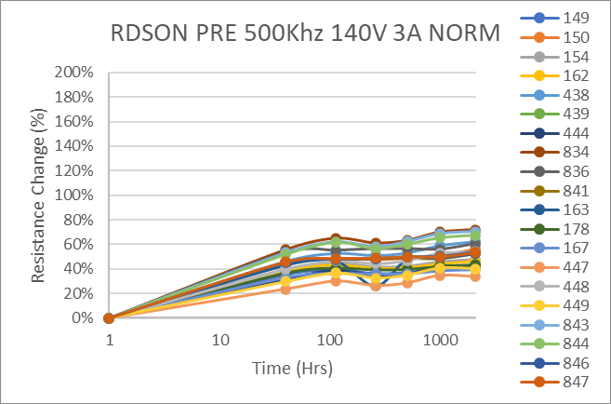
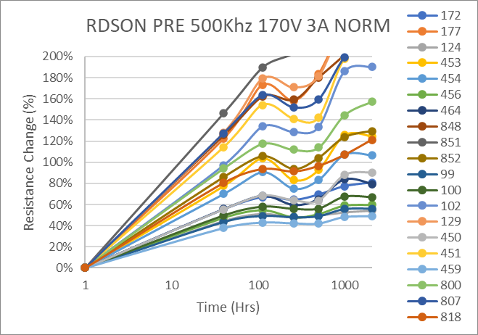
RDSON NORMALIZED
Take away : Rdson dependent to drain voltage no current dependence correlate to efficiency
Temperature seems to slow down the Drdson effect thru annealing . ( more pronounced on 100V device analysis)

Slide 10
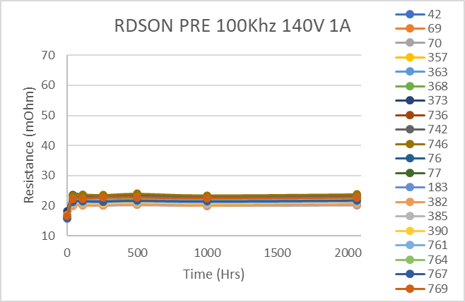
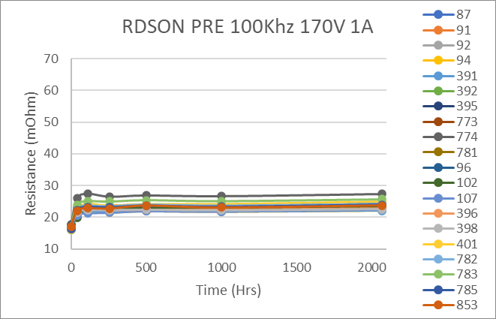
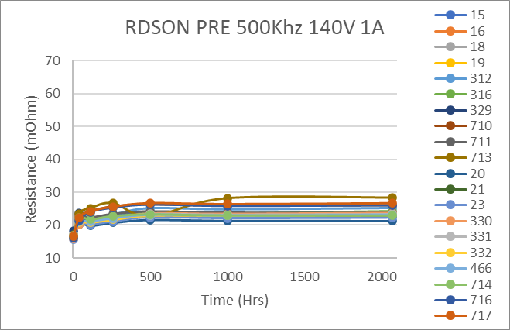
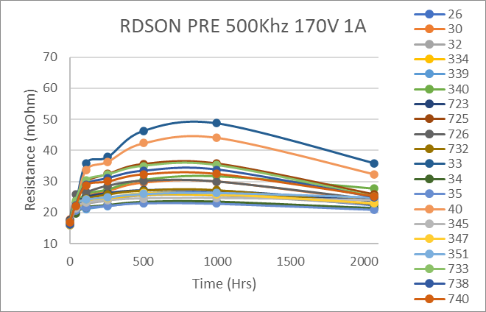
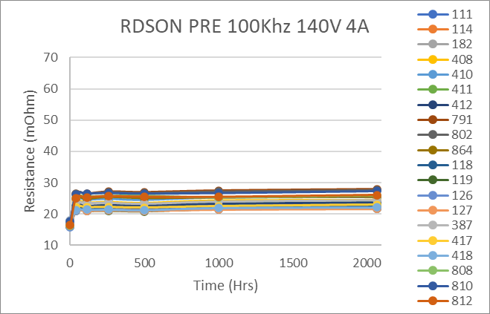
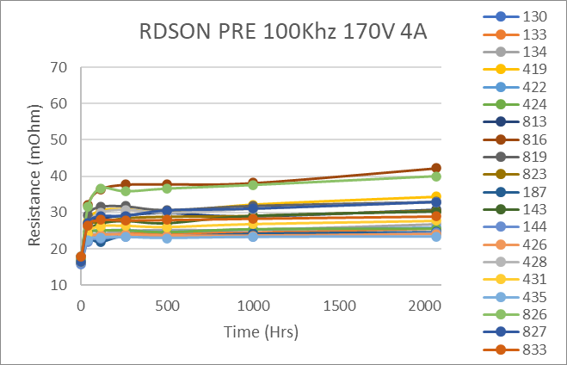
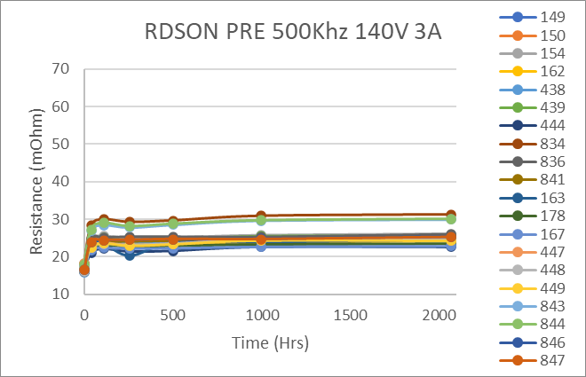
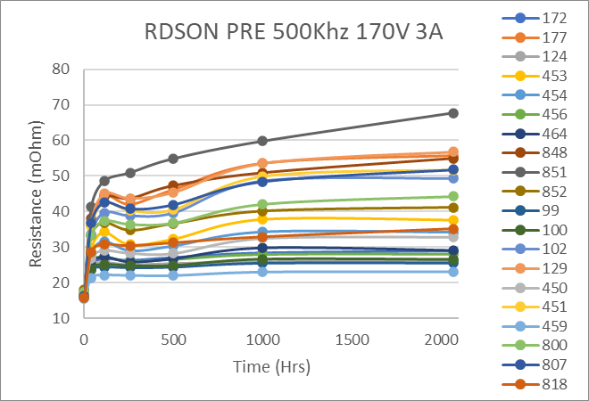
RDSON
Take away : Efficiency dependent to drain voltage no current dependence .
Temperature seems to slow down the Drdson effect thru annealing . ( more pronounced on 100V device analysis)

Slide 11
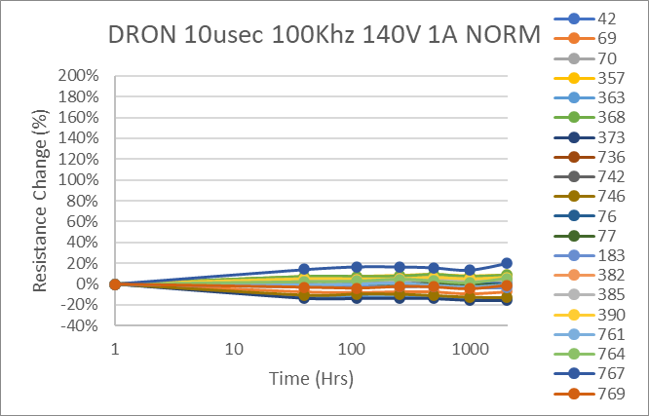
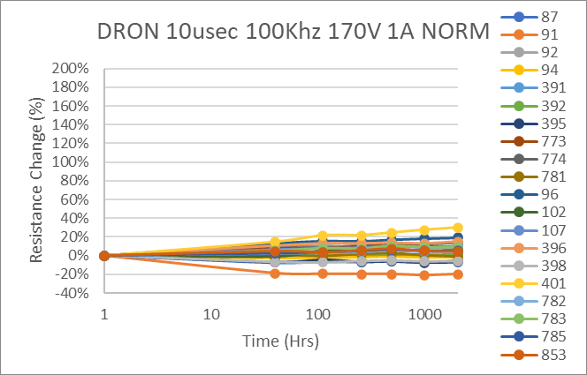
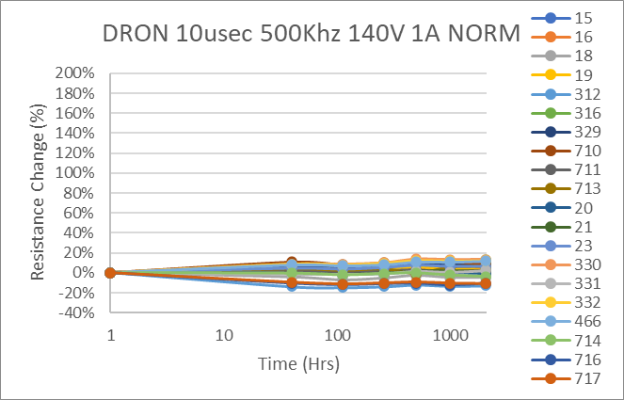
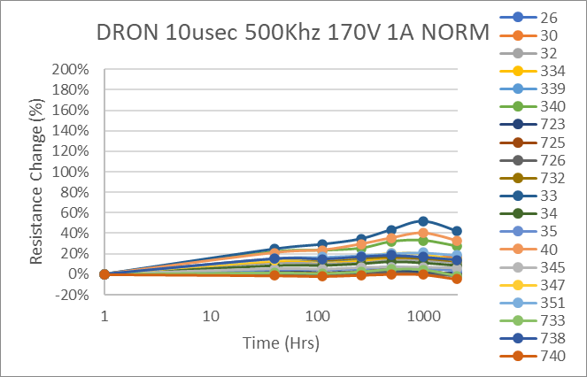
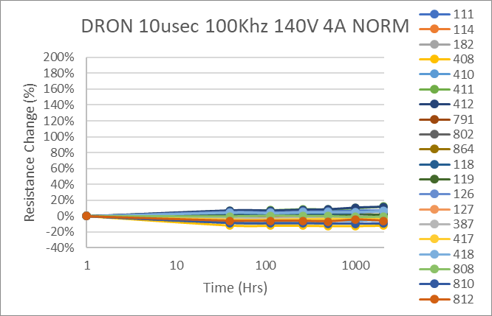
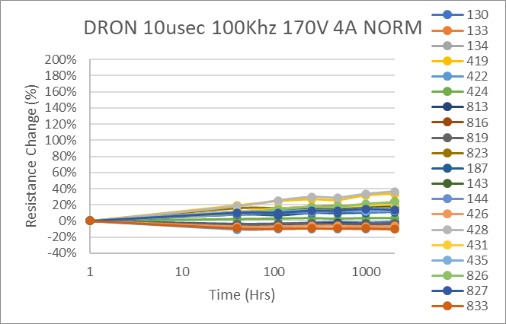
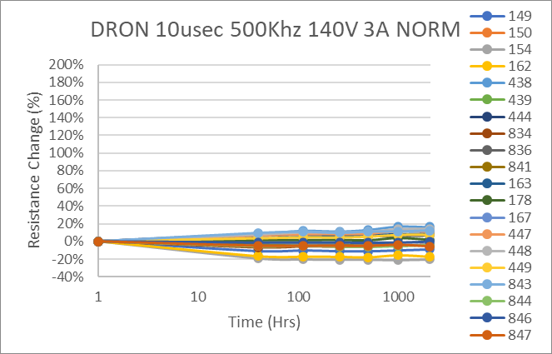
DRON Normalized
Take away : Drdon does not correlate to efficiency.
fast traps do nt seem to increase with longer stress compared to the slow traps (Rdson)

Slide 12
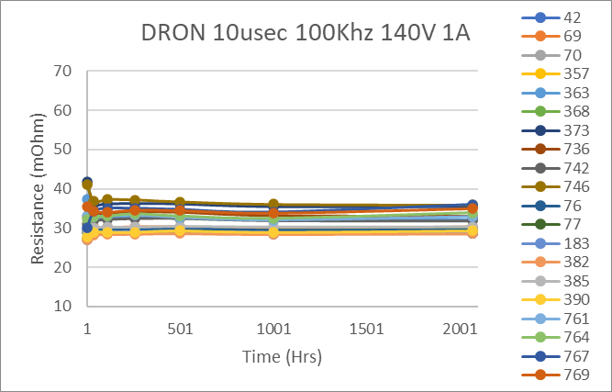
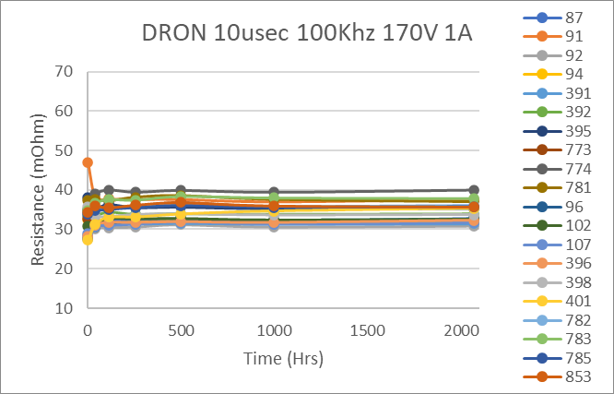
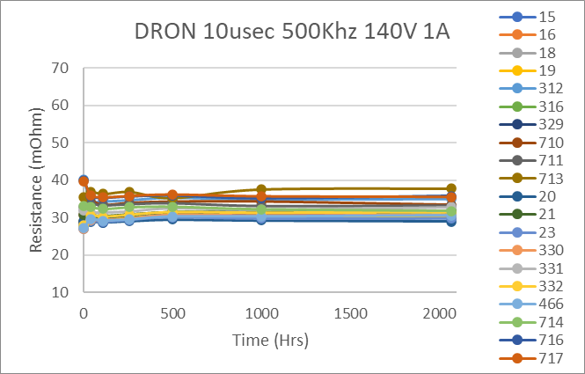
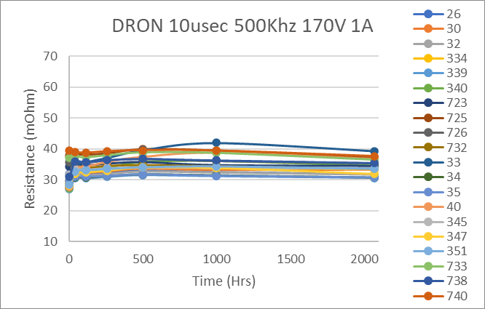
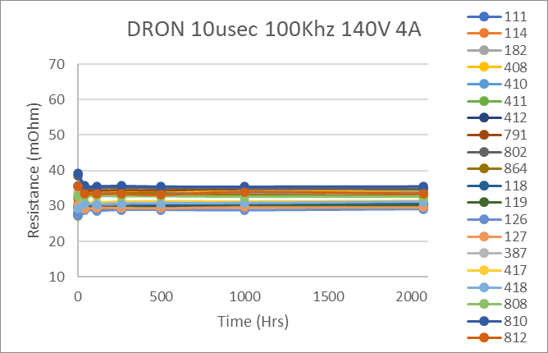
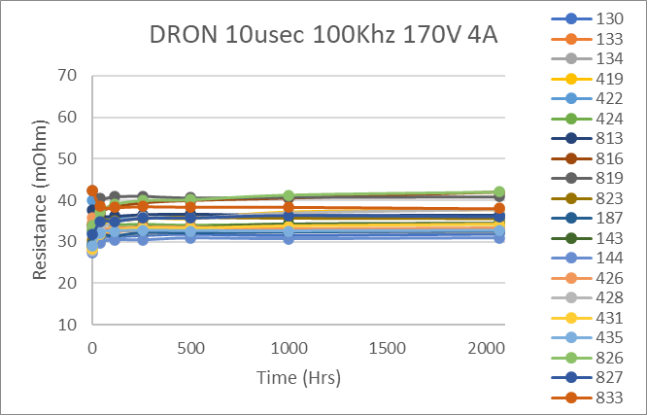
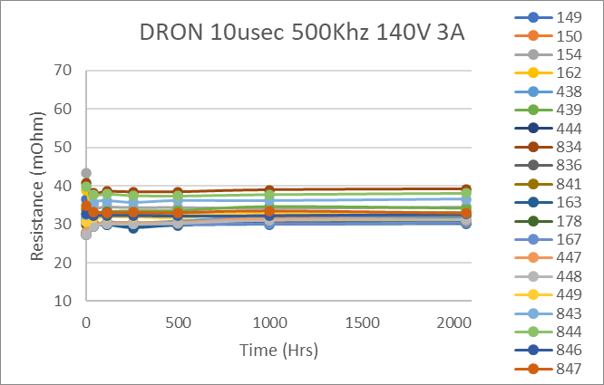
DRON

Slide 13
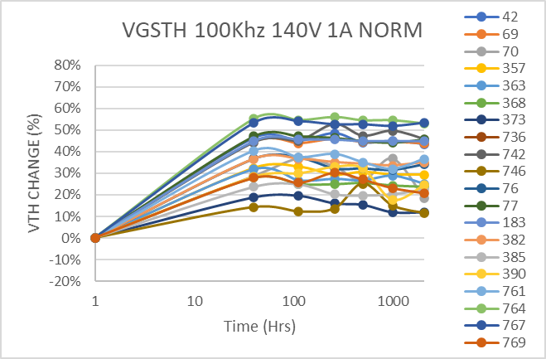







Vth Normalized
VTh performed pre Drdson and Idss on the Focused tester.
Initial shift but stable

Slide 14








Vth (raw data)

Slide 15








Vth-Post RDSON Test
VTh performed after Drdson and Idss on the Focused tester. Data
Talk to Rob S.

Slide 16








Vth-POST-PRE DELTA

Slide 17








IDSS
Leakages not affected

Slide 18








IGSS
Leakages not affected

Slide 19
Switching STRESS
Parts were grouped and run at successively higher voltage.
Test period was ~18 hours (Overnight)
Parts tested with full parametric test on Focused tester after every step.
Parts with very high leakage were removed at each step
X axis (voltage represents Applied stress voltage not test voltage)

Slide 20


Case temps and SOA limits
Take away : Switching losses are driving Case temp more than current

Slide 21



Switching Stress Parametric

Slide 22



Switching Stress Parametric

Slide 23
DC STRESS
Parts were grouped and run at successively higher voltage.
Test period was ~18 hours (Overnight)
Parts tested with full parametric test on Focused tester after every step.
Parts with very high leakage were removed at each step
X axis (voltage represents Applied stress voltage not test voltage)

Slide 24



HTRB OVEN LOGS

Slide 25



HTGB OVEN LOGS

Slide 26



IDSS - HTGB
VDS test voltage is 200V for all data points

Slide 27



IGSSF - HTGB
VGS test voltage is 5V for all data points

Slide 28



IGSSR - HTGB
VGS test voltage is -4V for all data points

Slide 29



VGSth - HTGB
Vgs th test is @ 3mA all data points

Slide 30



RDSON - HTGB
This drop caused by FTI fixture change
RDSON test is @ 18A, Vgs=5V
all data points

Slide 31



RDSON 1s - HTGB
This drop caused by FTI fixture change
RDSON test is @ 18A, Vgs=5V
all data points

Slide 32


DYNAMIC RON PRE STRESS - HTGB
This drop caused by FTI fixture change
DRON test is @ 15A, Vgs=5V
all data points.
10sec stress at 160V, test follows at
6-8us after stress

Slide 33



DYNAMIC RON POST STRESS - HTGB
DRON test is @ 15A, Vgs=5V
all data points.
DRON test is @ 15A, Vgs=5V
all data points.
10sec stress at 160V, test follows at
6-8us after stress

Slide 34



DYNAMIC RON % - HTGB
DRON test is @ 15A, Vgs=5V
all data points.
10sec stress at 160V, test follows at
6-8us after stress. Pre test @15A

Slide 35



IDSS - HTRB
VDS test voltage is 200V for all data points

Slide 36



IGSSF - HTRB
VGS test voltage is 5V for all data points

Slide 37



IGSSR - HTRB
VGS test voltage is -4V for all data points

Slide 38



VGSth - HTRB
Vgs th test is @ 3mA all data points

Slide 39



RDSON - HTRB
This drop caused by FTI fixture change.
Drop at 300V caused by annealing due to fuse
failure / low bias during oven exposure
RDSON test is @ 18A, Vgs=5V
all data points

Slide 40



RDSON 1s - HTRB
This drop caused by FTI fixture change.
Drop at 300V caused by annealing due to fuse
failure / low bias during oven exposure
RDSON test is @ 18A, Vgs=5V
all data points

Slide 41



DYNAMIC RON PRE STRESS - HTRB
This drop caused by FTI fixture change.
Drop at 300V caused by annealing due to fuse
failure / low bias during oven exposure
DRON test is @ 15A, Vgs=5V
all data points.
10sec stress at 160V, test follows at
6-8us after stress

Slide 42



DYNAMIC RON POST STRESS - HTRB
This drop caused by FTI fixture change.
Drop at 300V caused by annealing due to fuse
failure / low bias during oven exposure
DRON test is @ 15A, Vgs=5V
all data points.
10sec stress at 160V, test follows at
6-8us after stress

Slide 43



DYNAMIC RON % - HTRB
DRON test is @ 15A, Vgs=5V
all data points.
10sec stress at 160V, test follows at
6-8us after stress

Slide 44
OVEN LOG SUMMARY
 | HTRB Voltage | Current (mA) | # Parts | Avg Power per part | Notes | HTGB Voltage | Current (mA) | # Parts | Avg Power per part | Notes
110C | 160 | 0.141 | 10 | 0.002 |  | 4 | 0.023 | 10 | 0.0000
 | 180 | 0.198 | 10 | 0.004 |  | 5 | 0.056 | 10 | 0.0000
 | 200 | 0.212 | 10 | 0.004 |  | 6 | 0.144 | 10 | 0.0001
 | 210 | 0.125 | 10 | 0.003 |  | 6.25 | 0.28 | 10 | 0.0002
 | 220 | 0.11 | 10 | 0.002 |  | 6.5 | 0.4 | 10 | 0.0003
 | 230 | 0.131 | 10 | 0.003 | 1 part failed | 6.75 | 0.7 | 10 | 0.0005
 | 240 | 0.134 | 9 | 0.004 |  | 7 | 1.45 | 10 | 0.0010
 | 250 | 0.155 | 9 | 0.004 |  | 7.25 | 2.1 | 10 | 0.0015
 | 260 | 0.145 | 9 | 0.004 |  | 7.5 | 3.1 | 10 | 0.0023
 | 270 | 0.1 | 9 | 0.003 | 1 part failed blew DMM fuse | 7.75 | 4.5 | 10 | 0.0035
 | 280 | 0.1 | 8 | 0.004 |  | 8 | 7 | 10 | 0.0056 | 2 parts failed
 | 290 | 0.1 | 8 | 0.004 |  | 8.25 | 7 | 8 | 0.0072 | 2 parts failed
 | 300 | 0.1 | 8 | 0.004 | 1 part failed shorted supply | 8.5 | 27 | 6 | 0.0383 | 3 parts failed+ 1 part fails IGSS
130C | 160 | 0.3 | 10 | 0.005 |  | 4 | 0.05 | 10 | 0.0000
 | 180 | 0.3 | 10 | 0.005 |  | 5 | 0.1 | 10 | 0.0001
 | 200 | 0.31 | 10 | 0.006 | 1 part failed/replaced - Fixture possible | 6 | 0.4 | 10 | 0.0002
 | 210 | 0.29 | 10 | 0.006 | 1 part failed Fixture Possible | 6.25 | 0.63 | 10 | 0.0004
 | 220 | 0.28 | 9 | 0.007 |  | 6.5 | 1.15 | 10 | 0.0007
 | 230 | 0.28 | 9 | 0.007 | 1 part failed Fixture Possible | 6.75 | 1.53 | 10 | 0.0010
 | 240 | 0.33 | 8 | 0.010 |  | 7 | 2.5 | 10 | 0.0018
 | 250 | 0.35 | 8 | 0.011 |  | 7.25 | 3.8 | 10 | 0.0028
 | 260 | 0.51 | 8 | 0.017 | 1 part failed | 7.5 | 6.4 | 10 | 0.0048
 | 270 | 0.32 | 7 | 0.012 | 1 part failed | 7.75 | 8.3 | 10 | 0.0064 | 1 part failed
 |  |  |  |  |  | 8 | 8.6 | 9 | 0.0076 | 2 parts failed
 |  |  |  |  |  | 8.25 | 8.4 | 7 | 0.0099 | 3 parts failed
 |  |  |  |  |  | 8.5 | 5.1 | 4 | 0.011 | 1 part failed + 2 fail IGSS

Slide 45
OVEN LOG SUMMARY
 | HTRB Voltage | Current (mA) | # Parts | Avg Power per part | Notes | HTGB Voltage | Current (mA) | # Parts | Avg Power per part | Notes
150C | 160 | 0.692 | 10 | 0.011 | ` | 4 | 0.1 | 10 | 0.000
 | 180 | 0.719 | 10 | 0.013 |  | 5 | 0.16 | 10 | 0.000
 | 200 | 0.747 | 10 | 0.015 |  | 6 | 0.45 | 10 | 0.000
 | 210 | 0.76 | 10 | 0.016 | 2 parts failed | 6.25 | 0.71 | 10 | 0.000
 | 220 | 0.621 | 8 | 0.017 |  | 6.5 | 1.07 | 10 | 0.001
 | 230 | 0.647 | 8 | 0.019 | 1 part failed | 6.75 | 1.64 | 10 | 0.001
 | 240 | 0.617 | 7 | 0.021 |  | 7 | 2.45 | 10 | 0.002
 | 250 | 0.631 | 7 | 0.023 |  | 7.25 | 3.68 | 10 | 0.003
 | 260 | 0.653 | 7 | 0.024 | 1 part failed | 7.5 | 9.26 | 10 | 0.007 | 1 part fails IGSS
 | 270 | 0.593 | 6 | 0.027 |  | 7.75 | 11.6 | 10 | 0.009 | 1 part failed
 | 280 | 0.616 | 6 | 0.029 | 1 part failed | 8 | 47.7 | 9 | 0.042 | 3 parts fail IGSS
 |  |  |  |  |  | 8.25 | 114 | 9 | 0.105 | 1 part fails IGSS

Slide 46


HTRB FAILURE XRAY
110C-#5 – 230V
110C-#9 – 270V

Slide 47




HTRB FAILURE XRAY
130C-#17 – 200V
130C-#22 – 210V
130C-#15 – 230V
130C-#13 – 260V

Slide 48





HTRB FAILURE XRAY
150C-#28 – 210V
150C-#30 – 210V
150C-#37 – 230V
150C-#33 – 260V
150C-#36 – 280V

Slide 49
STRESS FAILURE SUMMARY
20N18 - STRESS Sumary
Temp | SN | Stress V | Notes | Action | Notes / Final Screening Value
110C | 7,8 | 8 | High Gate Leakage
 | 10 | 8.25 | High Gate Leakage
 | 11 | 8.25 | High Gate Leakage low Vgsth
 | 2,3,4,5 | 8.5 | High Gate Leakage
 | 5 | 230 | Vgsth Low high G and D Leakage |  | Possibel Fixture related
 | 9 | 270 | Vgsth Low high G and D Leakage
 | 14 | 300 | Vgsth Low high G and D Leakage
130C | 19 | 7.75 | High Leakage low Vgsth
 | 16, 19 | 8 | High Vgsth High gate leakage
 | 21,20 | 8.25 | Vgsth Low high G and D Leakage
 | 18 | 8.5 | High Vgsth High gate leakage
 | 17 | 200 | Low Vgs th High G and D Leakage |  | Possibel Fixture related
 | 22 | 210 | Low Vgs th High G and D Leakage |  | Possibel Fixture related
 | 15 | 230 | Low Vgs th High G and D Leakage |  | Possibel Fixture related
 | 13 | 260 | Low Vgs th High G and D Leakage
 | 27 | 270 | Low Vgs th High G and D Leakage
150C | 37 | 7.5 | High IGSS
 | 25 | 7.75 | Vgsth Low high G and D Leakage
 | 35,27,28 | 8 | High Gate Leakage
 | 37, 29 | 8.25 | High Gate Leakage
 | 28,30 | 210 | Vgsth Low high G and D Leakage
 | 37 | 230 | Vgsth Low high G and D Leakage
 | 33 | 260 | Vgsth Low high G and D Leakage
 | 36 | 280 | Vgsth Low high G and D Leakage

Slide 50
DC LIFE
Parts were run for 2000hrs at selected conditions
Parts tested with full parametric test on Focused tester at interim steps 24hrs, 48,hrs, 96hrs, 210hrs, 500hrs, 1000hrs, 1500hrs, 2000hrs
Parts with very high leakage were removed at each step
X axis (voltage represents Applied stress voltage not test voltage)

Slide 51




OVEN LOGS

Slide 52





HTGB LIFE
IDSS tested at 200V

Slide 53





HTGB LIFE
IGSSF tested at 5V

Slide 54





HTGB
IGSSR tested at -4V

Slide 55





HTGB
DRON pre at 15A VGS@5V

Slide 56





HTGB
DRON post at 15A VGS@5V
10s stress at 160V followed by
Test at 5-8us after removal

Slide 57





HTGB
RDSON at 18A VGS@5V

Slide 58





HTGB
Vgsth at 3mA

Slide 59





HTRB
IDSS tested at 200V

Slide 60





HTRB
IGSS tested at 5V

Slide 61





HTRB
IGSR tested at -4V

Slide 62





HTRB
DRON pre at 15A VGS@5V

Slide 63





HTRB
DRON post at 15A VGS@5V
10s stress at 160V followed by
Test at 5-8us after removal

Slide 64





HTRB
RDSON at 18A VGS@5V

Slide 65




HTRB
Vgsth at 3mA

Slide 66
LIFE TEST SUMMARY HTGB
Temp | Stress V | Time(Hrs) | SN | Wafer # | Notes
100C | 6.75
 |  | 1479 | 68 | Q211 | High IGSS, still functional-part was OOF
 |  | 2020 | 126 | Y003 | High IGSS, still functional-OOF replacemnt actual hours 1924
 | 7.25 | 96 | 81 | Q211 | Out of Family, High IGSS,IDSS, Vth - Part was OOF
 |  | 500 | 16 | Y046 | High IGSS -removed 1000Hrs
 |  | 1000 | 55 | Y003 | High IGSS, still functional
 |  |  | 60 | Q211 | High IGSS -removed 1000Hrs
 |  |  | 127 | Y003 | High IGSS, still functional
 |  | 1479 | 70 | Q211 | High IGSS, still functional-OOF replacment actual hours 1383
 |  | 2020 | 53 | Y003 | High IGSS, Vth, Idss nonfunctional
 |  |  | 59 | Q211 | High IGSS, Vth, Idss nonfunctional=Part was OOF
 |  |  | 61 | Q211 | High IGSS, low Vth, high Idss nonfunctional
 |  |  | 17 | Y046 | High IGSS, low Vth, high Idss nonfunctional
 |  | 2188 | 13 | Y046 | High IGSS, still functional
Temp | Stress V | Time(Hrs) | SN | Wafer # | Notes
150C | 6V
 | 6.75 | 1000 | 85 | Y003 | High IGSS, still functional
 |  | 2020 | 33 | Y046 | High IGSS, high Vth still functional
 |  | 2188 | 29 | Y046 | High Gate and Drain, Fuse Blew Pulled.
 | 7.25 | 48 | 39 | Q211 | High IGSS, still functional
 |  |  | 40 | Y046 | High IGSS, still functional
 |  | 138 | 37 | Y046 | High IGSS, IDSS, Low Vth
 |  | 210 | 42 | Q211 | High IGSS, still functional
 |  |  | 34 | Y046 | High IGSS, still functional-removed 100Hrs
 |  | 500 | 78 | Y003 | High IGSS, IDSS, High Vth
 |  | 1000 | 43 | Q211 | High IGSS, still functional
 |  |  | 44 | Q211 | High IGSS, still functional
 |  |  | 84 | Q211 | High IGSS, still functional
 |  |  | 35 | Y046 | High IGSS, still functional-removed 100Hrs
 |  |  | 40 | Y046 | High IGSS, still functional-removed 100Hrs
 |  |  | 75 | Y003 | High IGSS, still functional
 |  |  | 79 | Y003 | High IGSS, still functional-removed 100Hrs
 |  | 1479 | 130 | Y003 | High IGSS, still functional
 |  |  | 36 | Y046 | High IGSS, still functional
 |  | 2020 |  |  | No New Failures - 4 surviving parts 1 of which was OOF

Slide 67
LIFE TEST SUMMARY HTRB
Temp | Stress V | Time(Hrs) | SN | Wafer # | Notes
100C | 200V
 | 230V | 1020 | 94 | Y003 | Fuse blown, pulled
 |  | 1526 | 90 | Y003 | Fuse blown, pulled
 |  |  | 110 | Q211 | Fuse blown, pulled
 | 250V | 24 | 119 | Q211 | Fuse blown, pulled
 |  | 48 | 121 | Y003 | Fuse blown, pulled
 |  | 500 | 117 | Q211 | Fuse blown, pulled
 |  | 1020 | 100 | Y003 | Fuse blown, pulled
 |  | 1526 | 101 | Y003 | Fuse blown, pulled
 |  | 2048 | 121 | Q211 | Fuse blown, pulled
 |  |  | 123 | Q211 | Fuse blown, pulled
Temp | Stress V | Time(Hrs) | SN | Wafer # | Notes
130C | 200V | 24 | 120 | Y003 | Fuse blown, pulled
 |  | 500 | 102 | Y003 | Fuse blown, pulled
 |  | 1020 | 105 | Y003 | Fuse blown, pulled
 |  | 1426 | 107 | Y003 | Fuse blown, pulled
 |  |  | 130 | Q211 | Fuse blown, pulled
 | 230V | 48 | 140 | Q211 | Fuse blown, pulled
 |  | 210 | 109 | Y003 | Fuse blown, pulled
 |  | 500 | 112 | Y003 | Fuse blown, pulled
 |  | 1020 | 119 | Y003 | Fuse blown, pulled
 |  | 1526 | 74 | Q211 | Fuse blown, pulled
 |  |  | 138 | Q211 | Fuse blown, pulled
* | No failures seen from wafer Y046

Slide 68






HTRB Failures XRAY 230V 100C
Y003 #94-PRE-POST
Y003 #90-PRE-POST
Q211 #110-PRE-POST

Slide 69






HTRB Failures XRAY 250V 100C
Q211 #119-PRE POST
Y003 #121-PRE POST
Q211 #117-PRE POST

Slide 70






HTRB Failures XRAY 250V 100C
Y003 #100-PRE POST
Y003 #101-PRE POST
Q211 #121-PRE POST

Slide 71


HTRB Failures XRAY 250V 100C
Q211 #123-PRE POST

Slide 72






HTRB Failures XRAY 200V 130C
Y003 #120-PRE POST
Y003 #102-PRE POST
Y003 #105-PRE POST

Slide 73




HTRB Failures XRAY 200V 130C
Y003 #107-PRE POST
Q211 #130-PRE POST

Slide 74






HTRB Failures XRAY 230V 130C
Q211 #140-PRE POST
Y003 #109-PRE POST
Y003 #112-PRE POST

Slide 75





HTRB Failures XRAY 230V 130C
Y003 #119-PRE POST
Q211 #74-PRE POST
Q211 #138-PRE POST

